Slide 2
Part 3
Data collection (methodologies)

Slide 3
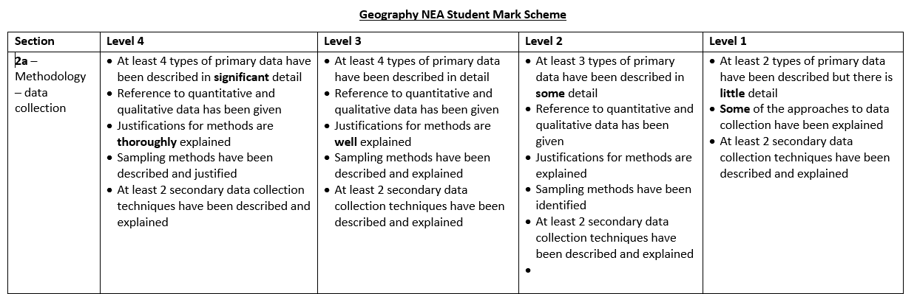

Slide 4
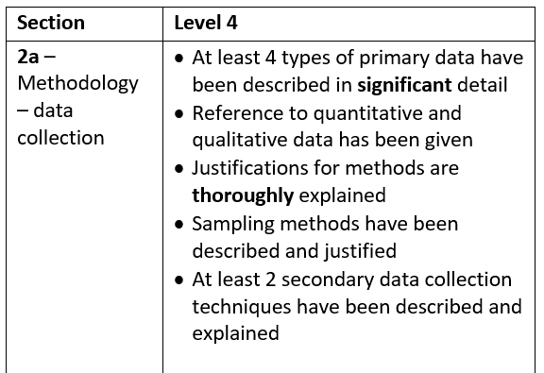

Slide 5
Sampling techniques
The sample is the limited number of measurements that you make
The population is the total number of measurements that you could potentially take
A totally representative sample will tell you everything you might need to know about the population
Types of sampling
Random, systematic, stratified.

Slide 6
Random sampling
Each sample item must have an equal chance of being selected.
This avoids bias
Allocate a number to each member of the parent population and select from a random number table.

Slide 7
Systematic sampling
Rather than choosing each individual or point to be sampled a regular pattern is used.
Can be more accurate than a random sample as is spread out over the population.
E.g. Sampling of depth on a river cross section

Slide 8
Stratified sampling
Can be used when there are significant groups of a known size in a parent population.
E.g. 50% of land in and area is grass, 50% is woodland. A stratified sample ensures than 50% of sample data is from each.

Slide 10
Candidates use a RANGE of appropriate techniques (quantitative & qualitative)
Good practice to link each technique specifically to a sub-hypothesis
A diverse mix of methods, specific well chosen sampling techniques for each method

Slide 11
Primary data collection techniques that could be used:
Environmental quality surveys.
Local and visitors’ perception questionnaires.
In-depth stakeholder interviews surveying of length of tenencies of businesses within a 200 m radius of the FD Arena.
Service count and surveys (land use).
Pedestrian and traffic counts.

Slide 12
Primary data that I will need to collect for Q1
Questionnaires about local people’s perceptions of the FD Arena.
Stratified: 20 young (under 30), 20 middle-aged (31-60), 20 senior (61+).
Questionnaires data about visitors’ perceptions of the FD Arena.
Stratified: 20 young (under 30), 20 middle-aged (31-60), 20 senior (61+).

Slide 13
Secondary data that I will need to collect for Q1
Local news articles containing responses to the FD Arena.
Articles from the national press containing responses to the FD Arena.
Articles from global media containing responses to the FD Arena.

