Slide 2
Part 4
Data presentation

Slide 3
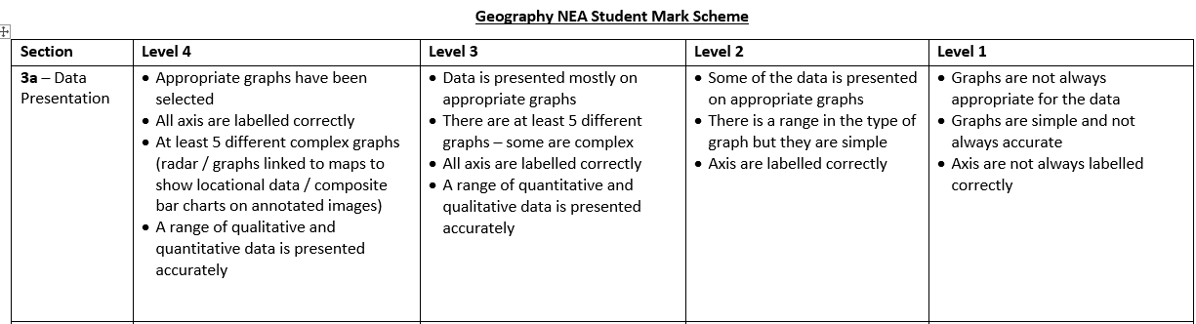

Slide 4
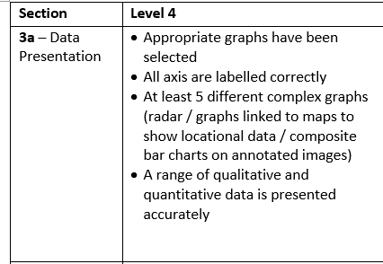

Slide 6
A range of appropriate, suitable: statistical, quantitative and qualitative techniques used
There should be a very clear spatial element to their data presentation i.e. presented on maps
Complex/sophisticated techniques include choropleth, flowline, scatter graphs, located proportional graphs

Slide 7
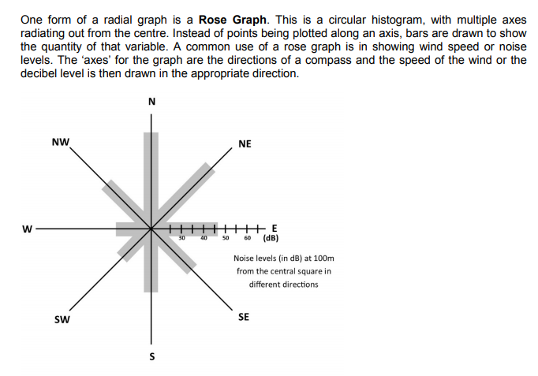
3. How does the built environment within a 200 metre radius of the FD Arena compare to adjoining neighbourhoods?
I would use a Rose Graph to show the scores of my environmental quality surveys which I would do at each compass point at 50, 100, 150, 200, 250, 300, 350 and 400m (systematic) distances from the First Direct Arena.

